Slide 1
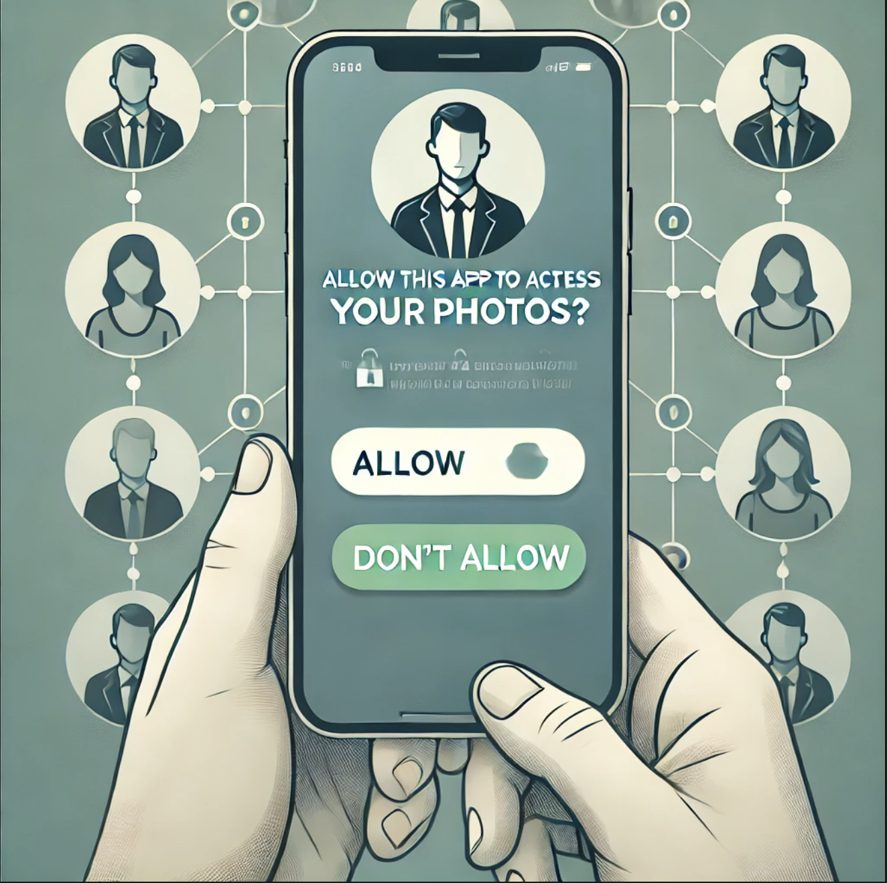
Interdependent Privacy in Smartphone App Permissions
Replication Study by: Manila Devaraja (u1320404), Jens Phanich (u0916721), Sharath Satish (u1471908)
Maximilian Marsch, Jens Grossklags, and Sameer Patil. 2021. Won't You Think of Others?: Interdependent Privacy in Smartphone App Permissions. Proc. ACM Hum.-Comput. Interact. 5, CSCW2, Article 437 (October 2021), 35 pages. https://doi.org/10.1145/3479581

Slide 2
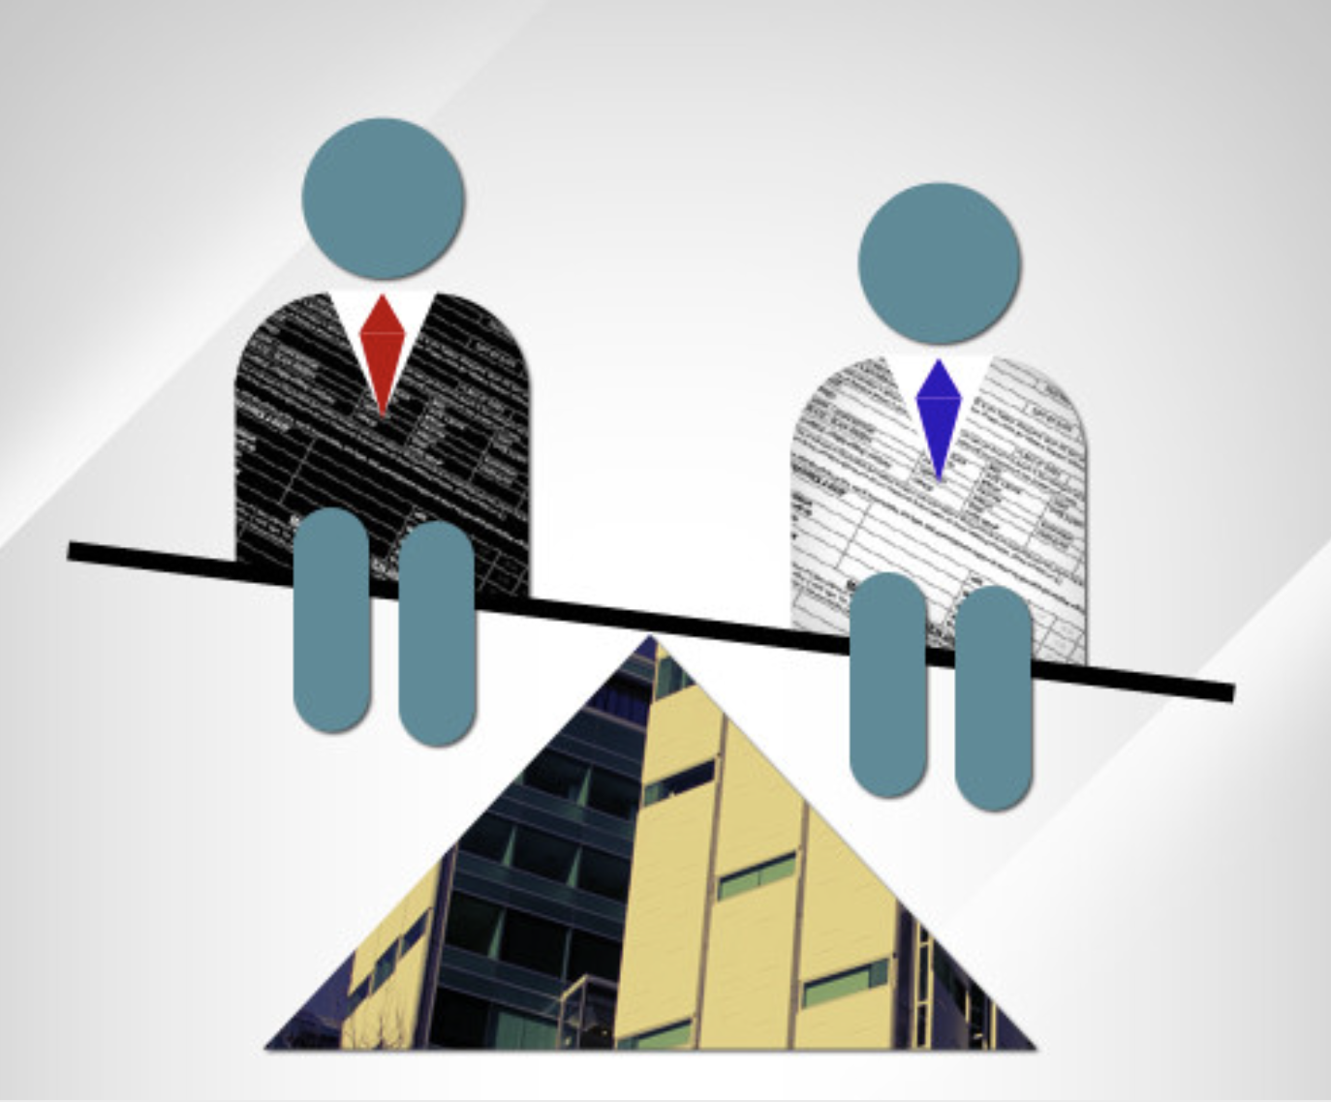
What is Interdependent Privacy?
“The privacy of individuals does not only depend on our own actions but may also be affected by the privacy decisions and by the data shared by other individuals.”
Image from LinkedIn
Maximilian Marsch, Jens Grossklags, and Sameer Patil. 2021. Won't You Think of Others?: Interdependent Privacy in Smartphone App Permissions. Proc. ACM Hum.-Comput. Interact. 5, CSCW2, Article 437 (October 2021), 35 pages. https://doi.org/10.1145/3479581

Slide 3
Interdependent Privacy in Smartphone App Permissions
“Thomas is an undergraduate student at his local University. He is looking for a new app for his smartphone. After some searching, he found an app which he installed on his phone without hesitation. This app asked for access to [calendar / contacts / photos / files and folders ], which Thomas granted. In the following, you can see a screenshot of his [calendar / contacts / photos / files and folders ]. Have a closer look at his [calendar / contacts / photos / files and folders ]. In the background, the application is sending the information stored in the [calendar / contacts / photos / files and folders ] to the server of the app maker.”
Maximilian Marsch, Jens Grossklags, and Sameer Patil. 2021. Won't You Think of Others?: Interdependent Privacy in Smartphone App Permissions. Proc. ACM Hum.-Comput. Interact. 5, CSCW2, Article 437 (October 2021), 35 pages. https://doi.org/10.1145/3479581

Slide 4
Research Questions from the Original Study
RQ1: Do individuals consider the privacy of other people when making decisions pertaining to smartphone app permissions?
RQ2: Does presenting information cues that feature other people prime users to give greater consideration to the privacy of others when making decisions pertaining to smartphone app permissions?
RQ3: Do concerns for privacy of other people vary based on the type of permission (specifically, calendar, contacts, photos) requested by a smartphone app?
Maximilian Marsch, Jens Grossklags, and Sameer Patil. 2021. Won't You Think of Others?: Interdependent Privacy in Smartphone App Permissions. Proc. ACM Hum.-Comput. Interact. 5, CSCW2, Article 437 (October 2021), 35 pages. https://doi.org/10.1145/3479581

Slide 5
Research Questions from the Replication Study
RQ1: Do individuals consider the privacy of other people when making decisions pertaining to smartphone app permissions?
RQ2: Does presenting information cues that feature other people prime users to give greater consideration to the privacy of others when making decisions pertaining to smartphone app permissions?
RQ3: Do concerns for privacy of other people vary based on the type of permission (specifically, calendar, contacts, photos, files and folders) requested by a smartphone app?
RQ4: Do individuals think it is important for others to consider their privacy when giving permissions to smartphone applications?
Maximilian Marsch, Jens Grossklags, and Sameer Patil. 2021. Won't You Think of Others?: Interdependent Privacy in Smartphone App Permissions. Proc. ACM Hum.-Comput. Interact. 5, CSCW2, Article 437 (October 2021), 35 pages. https://doi.org/10.1145/3479581

Slide 6
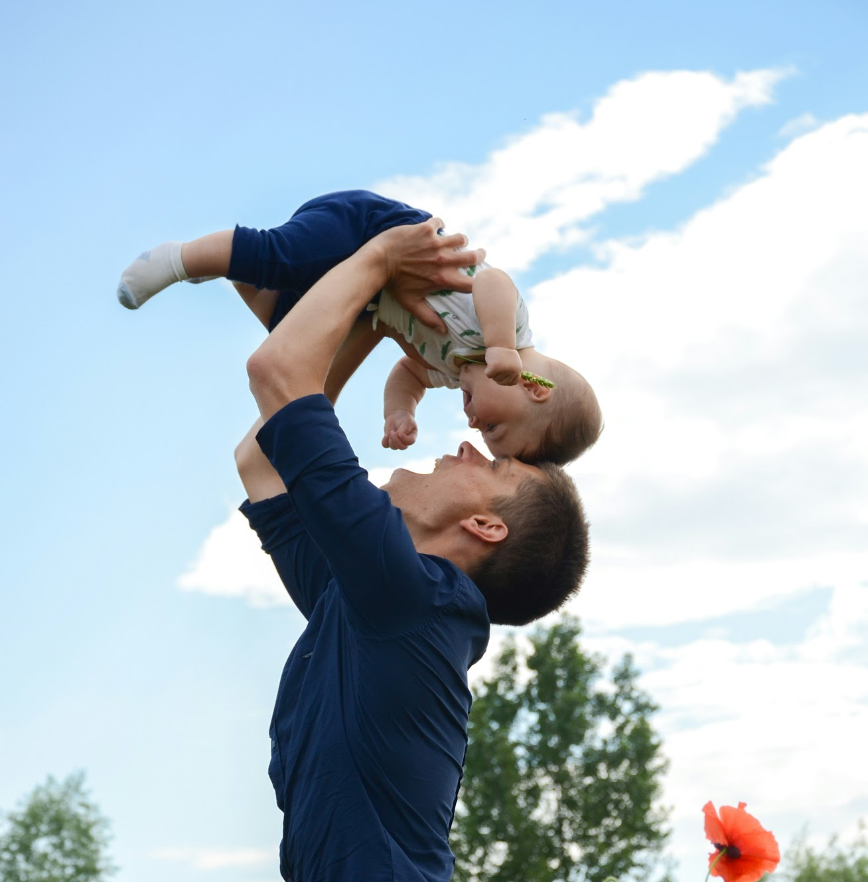
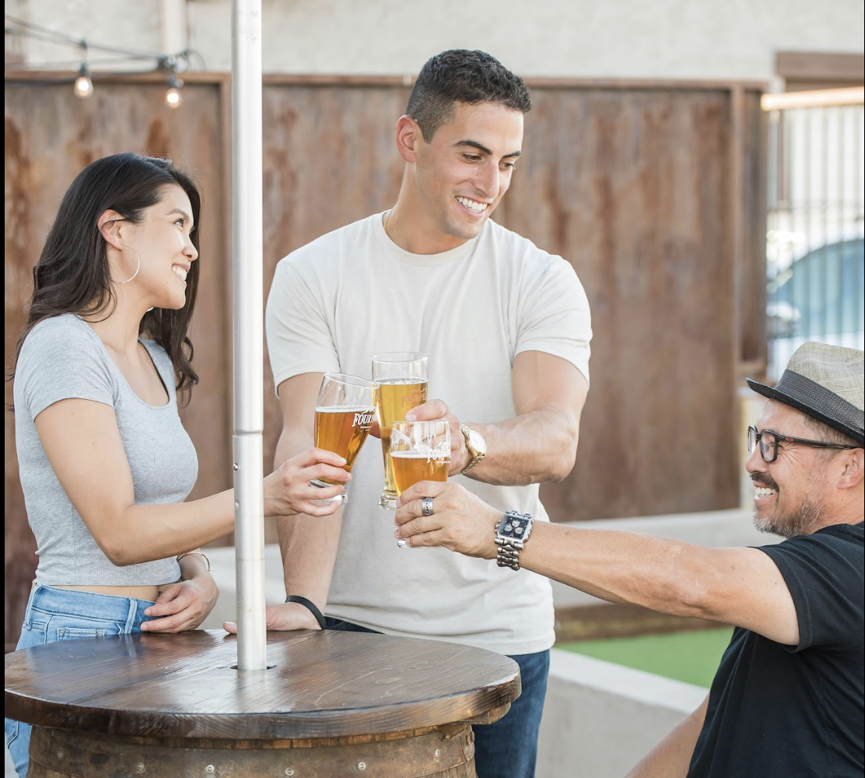


Scenarios - Person vs Non-Person
Calendar - Person
Contacts - Person
Photos - Person
17:00 Alicia’s birthday party
Abraham Foley | (385)-111-2222 | DOB: 10/19/92
21:30 Movie night with Tom
Tom Latham | (385)-222-3333 | DOB: 05/10/90
13:00 Barbeque with Rick
Alicia Rendall | (801)-555-8888 |
DOB: 06/22/97
Images from Unsplash
Calendar - Non-Person
Contacts - Non-Person
Photos - Non-Person
09:00 CS 10 - Deep Learning
Chandler Ltd. | (385)-674-3453
14:00 MATH 25 - Statistics
Moore PLC | (385)-353-2342
11:00 CS 60 - Security
Taco Bell | (801)-334-3453

Slide 7
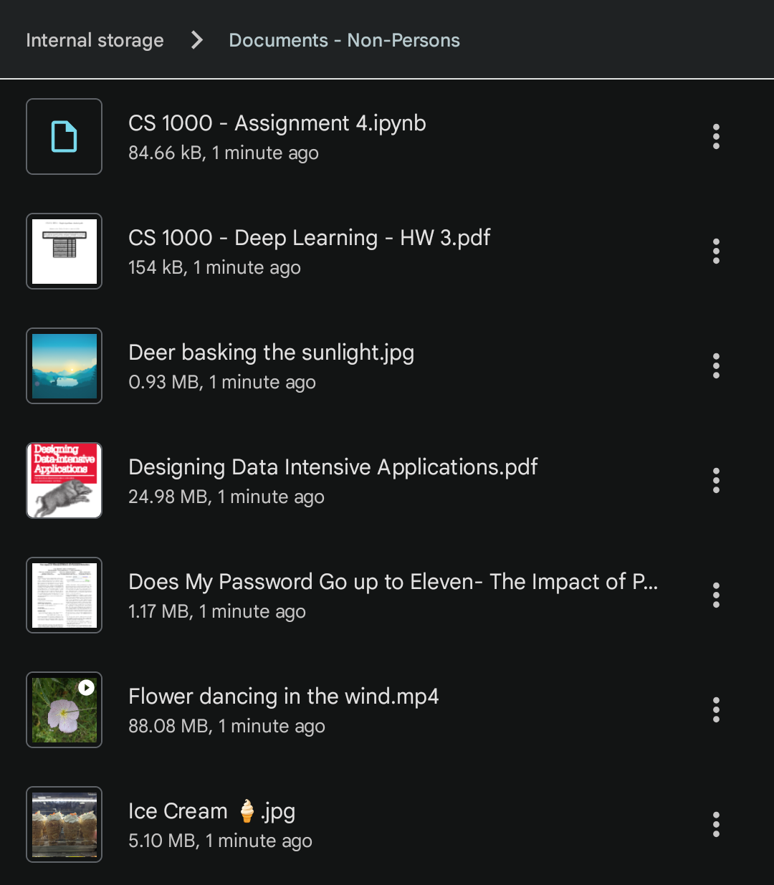
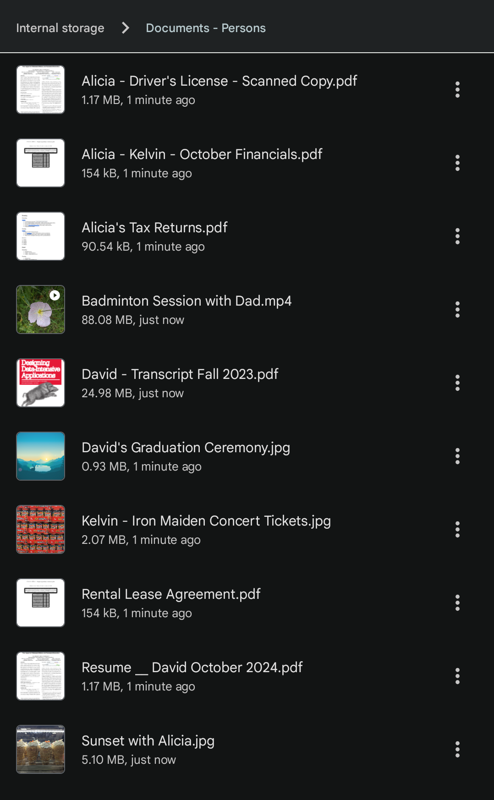
What’s new in the survey?
Scenario - File System - Non-Persons
Scenario - File System - Persons

Slide 8
What’s new in the survey?
RQ4: Do individuals think it is important for others to consider their privacy when giving permissions to smartphone applications?
Assuming you were Thomas's friend and knew that this app has access to Thomas’s photos
Would you want Thomas to install this app?

Slide 9
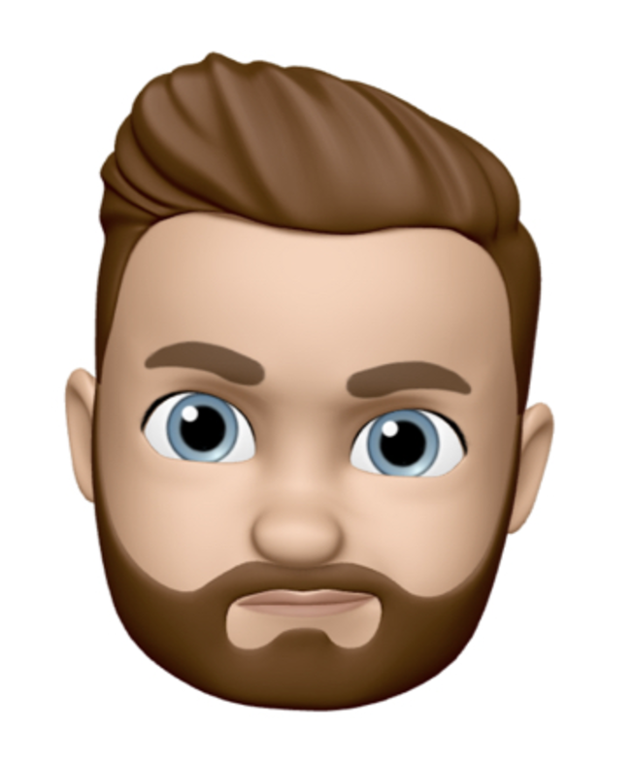
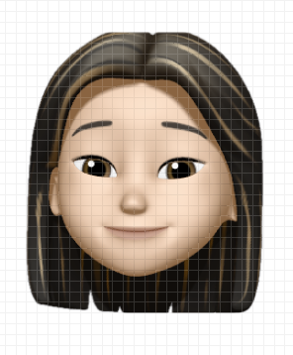
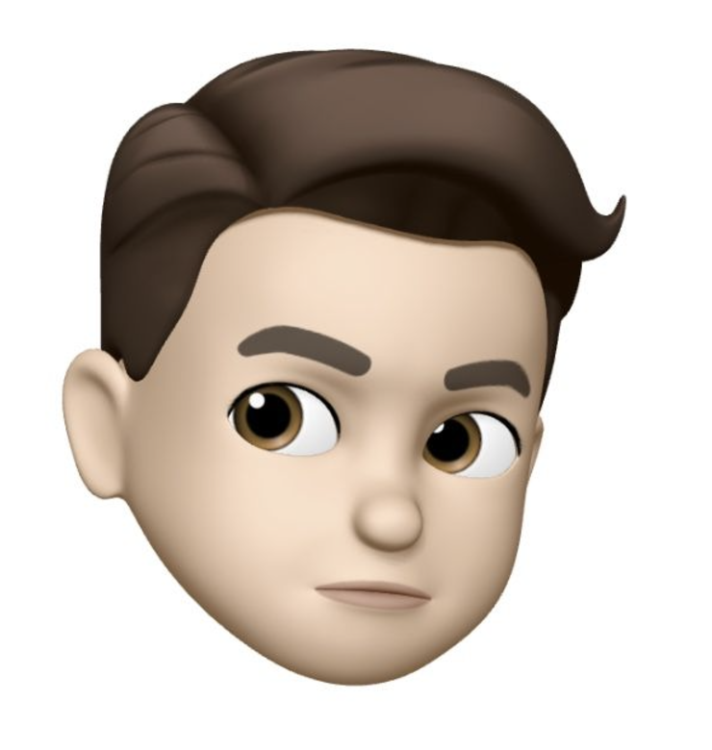
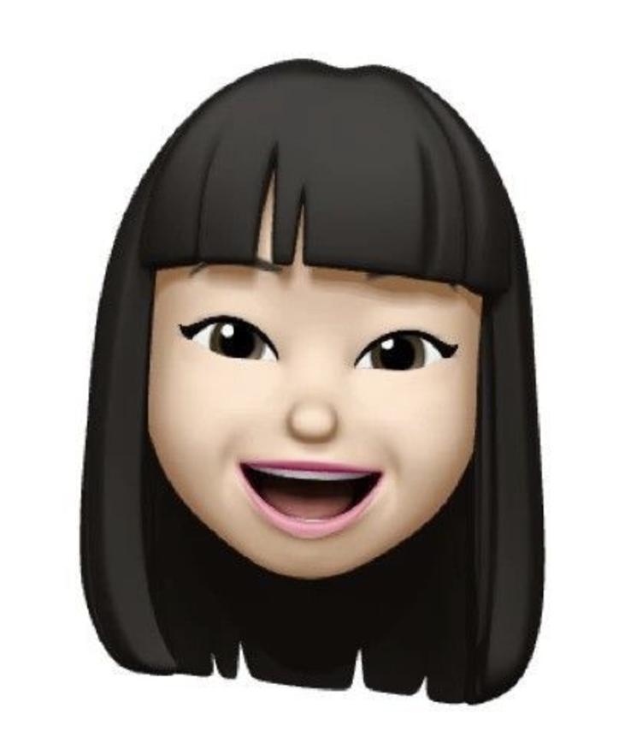
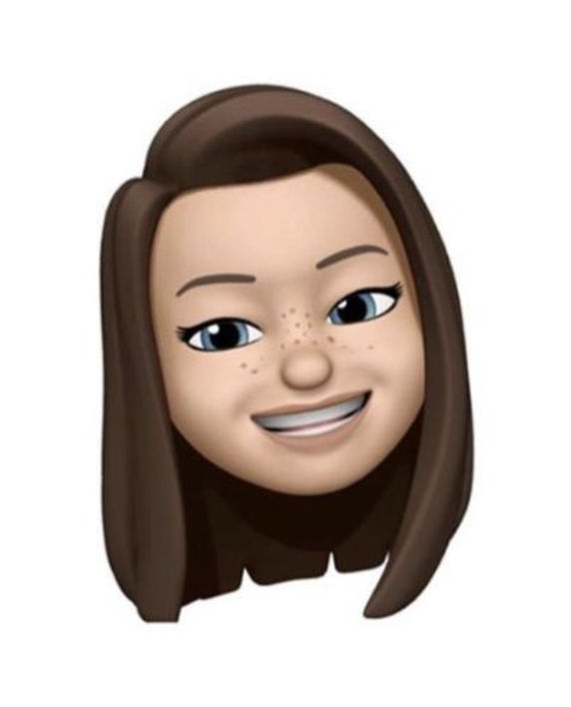
Survey Method
Built survey on Qualtrics
Stage 1
4 * 2 Vignettes
Calendar, Photos, Contacts, Files and Folders for Persons and Non-Persons
Stage 2
Random
Assignment
Gather student participants
Publish survey and
gather responses
Analyze participant responses
Stage 3

Slide 10
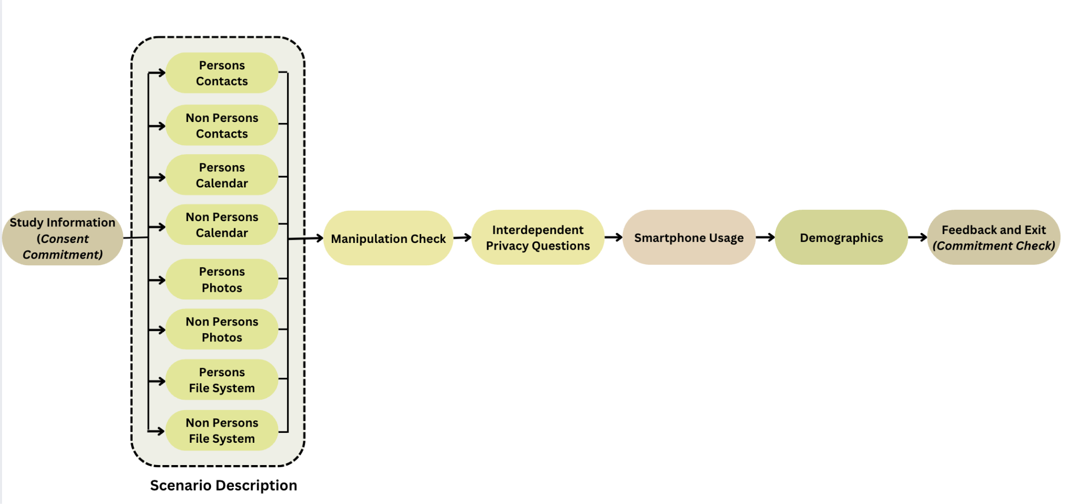
Survey Design
Notes:
Can you mention that most tests assume that the data follows a normal distribution? Given fewer number of participants in each scenario, there were not enough data points to get a lower significant p-value.

Slide 11
Survey Data Cleaning
Number of Participants = 34
(6 participants failed to identify the correct scenario)
Attention Check Defaulters = 2
Valid Number of Participants = 32
Participant Random Assignment Count
Calendar
Persons
5
Calendar
Non-Persons
4
Contacts
Persons
3
Contacts
Non-Persons
4
Photos
Persons
5
Photos
Non-Persons
5
File System
Persons
3
File Systems
Non-Persons
4

Slide 12
Demographic of Participants (n=32)
Gender
Man
23
Woman
7
Non-Binary
1
Prefer not to say
1
Ethnicity
Asian
17
White or Caucasian
8
Asian or White or Caucasian
2
Prefer not to say
2
Hispanic
1
Hispanic or White or Caucasian
1
Asian or Hispanic or White or Caucasian
1

Slide 13
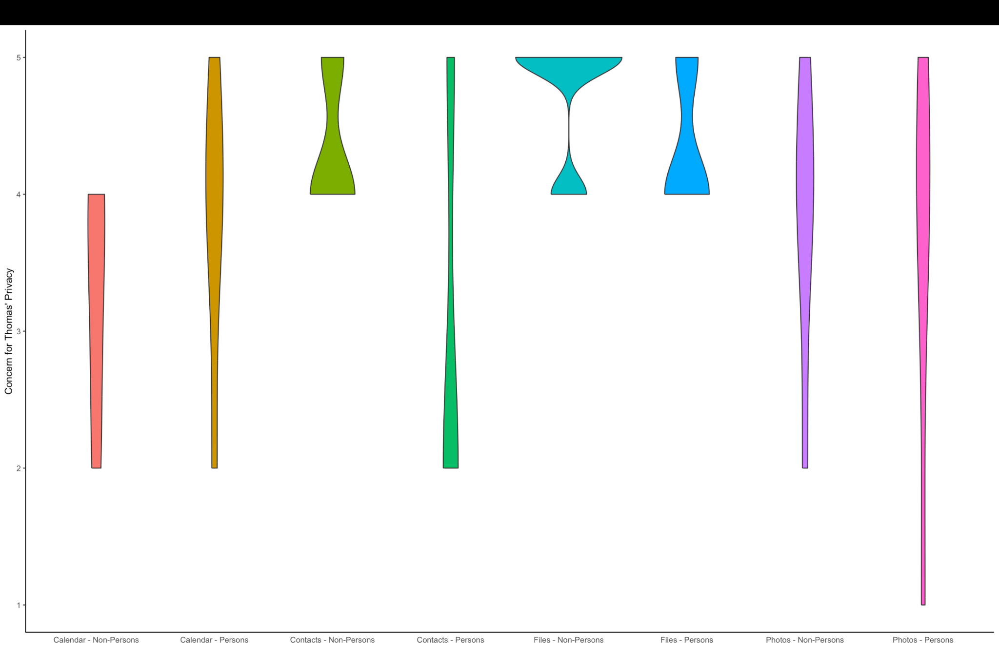
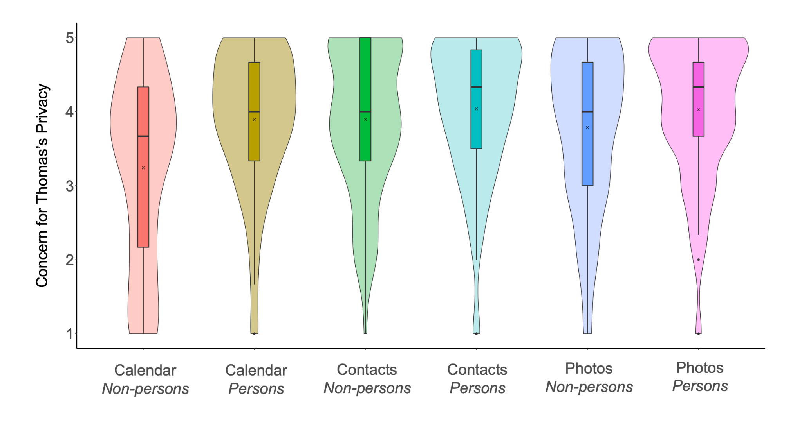
Concerns over Thomas’ Privacy
Replication Study, n=32
Maximilian Marsch, Jens Grossklags, and Sameer Patil. 2021. Won't You Think of Others?: Interdependent Privacy in Smartphone App Permissions. Proc. ACM Hum.-Comput. Interact. 5, CSCW2, Article 437 (October 2021), 35 pages. https://doi.org/10.1145/3479581
Original Study, n=633

Slide 14
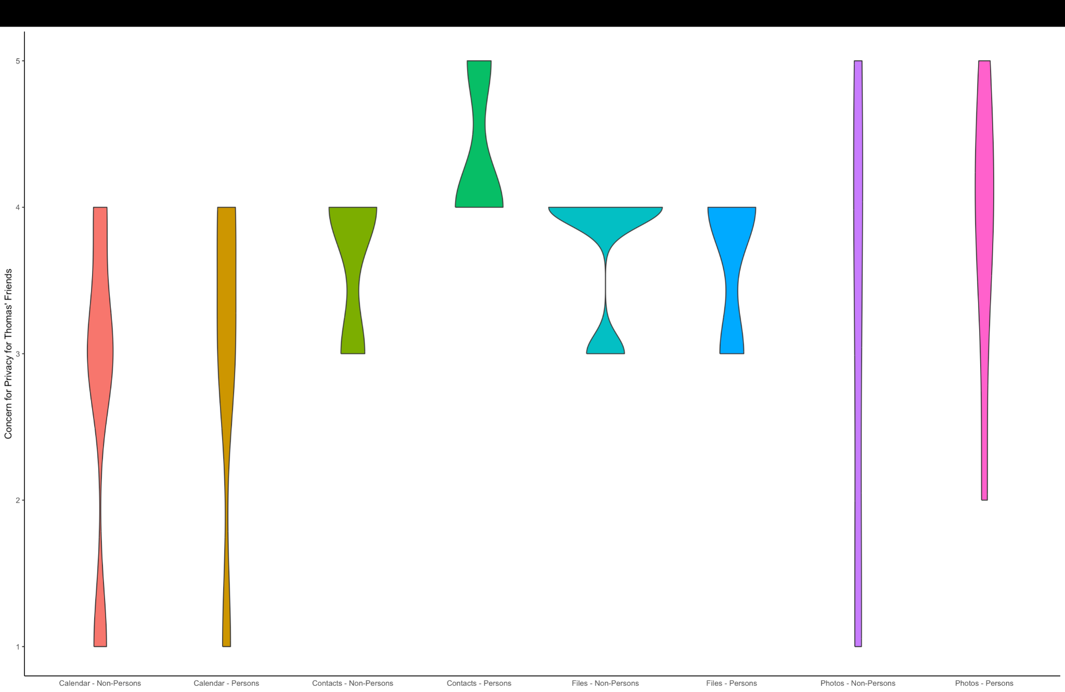
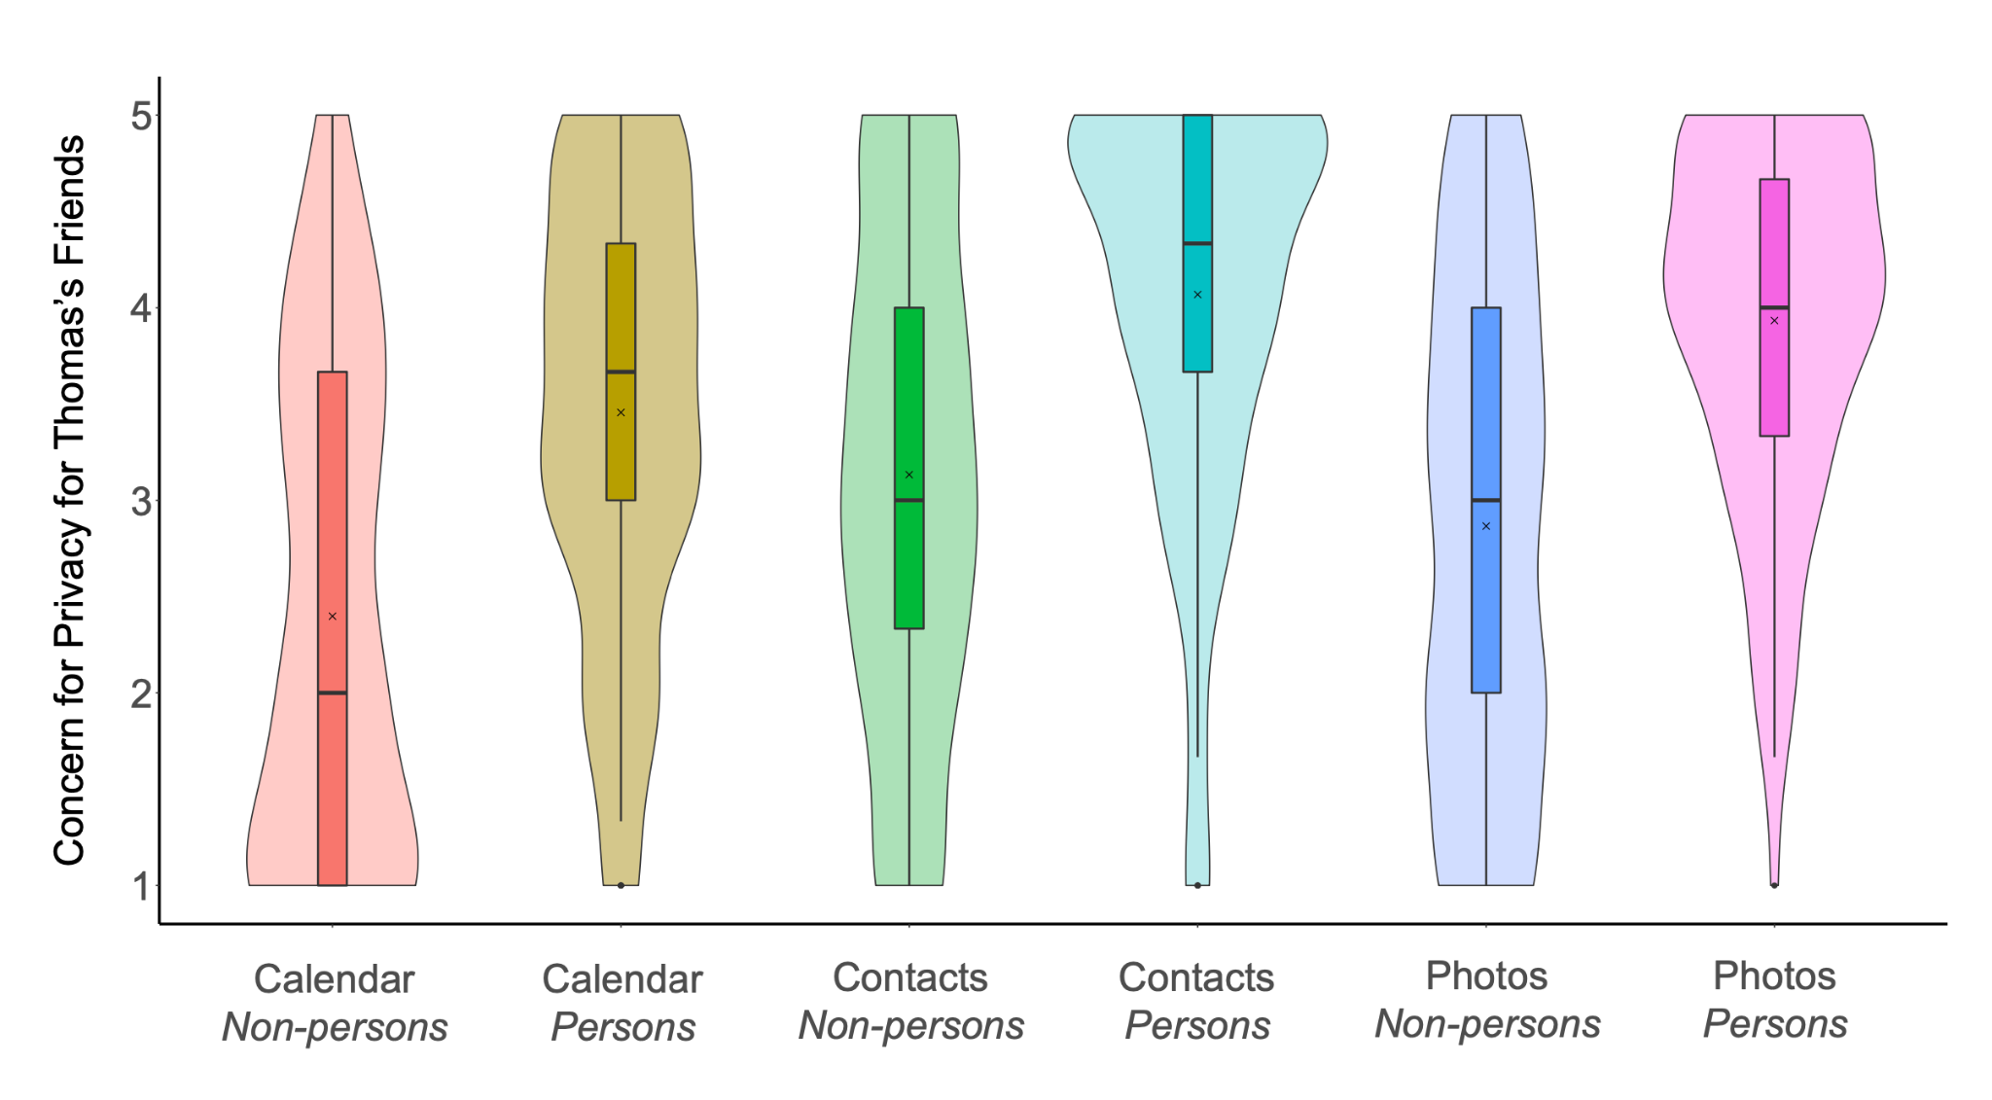
Concerns over Thomas’s friends privacy
Replication Study, n=32
Maximilian Marsch, Jens Grossklags, and Sameer Patil. 2021. Won't You Think of Others?: Interdependent Privacy in Smartphone App Permissions. Proc. ACM Hum.-Comput. Interact. 5, CSCW2, Article 437 (October 2021), 35 pages. https://doi.org/10.1145/3479581
Original Study, n=633

Slide 15
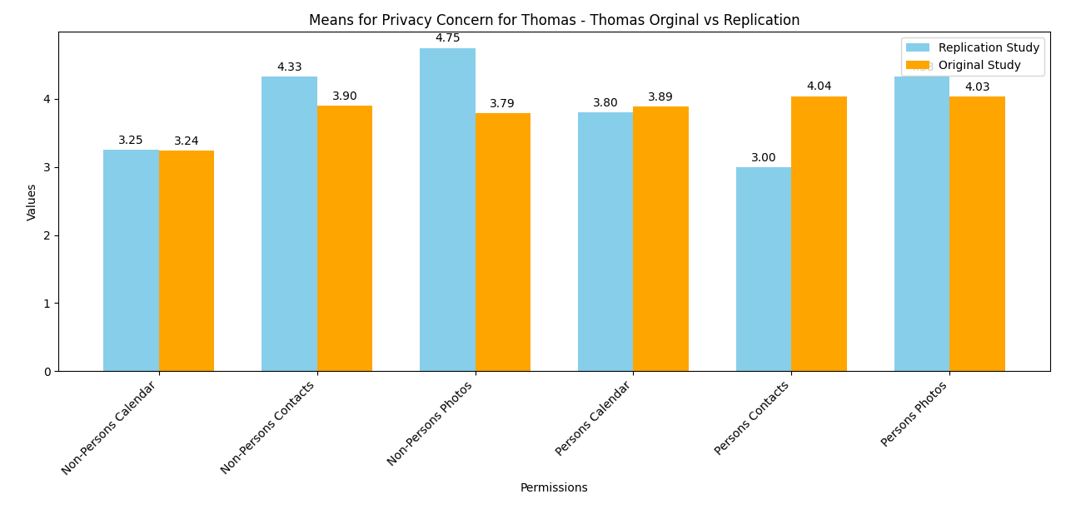
Means for Privacy Concern for Thomas
Maximilian Marsch, Jens Grossklags, and Sameer Patil. 2021. Won't You Think of Others?: Interdependent Privacy in Smartphone App Permissions. Proc. ACM Hum.-Comput. Interact. 5, CSCW2, Article 437 (October 2021), 35 pages. https://doi.org/10.1145/3479581
*Higher is better

Slide 16
Means for Privacy Concern for Thomas
Permission | Non-Persons | Persons | Difference
Calendar | 3.25 | 3.80 | 0.55
Contacts | 4.33 | 3 | 1.33
Photos | 4.75 | 4.33 | 0.42
File System | 3.8 | 3.6 | 0.2
Replication Study, n=32
Permission | Non-Persons | Persons | Difference
Calendar | 3.24 | 3.89 | 0.65
Contacts | 3.90 | 4.04 | 0.14
Photos | 3.79 | 4.03 | 0.24
Maximilian Marsch, Jens Grossklags, and Sameer Patil. 2021. Won't You Think of Others?: Interdependent Privacy in Smartphone App Permissions. Proc. ACM Hum.-Comput. Interact. 5, CSCW2, Article 437 (October 2021), 35 pages. https://doi.org/10.1145/3479581
Original Study, n=633
*Higher is better

Slide 17
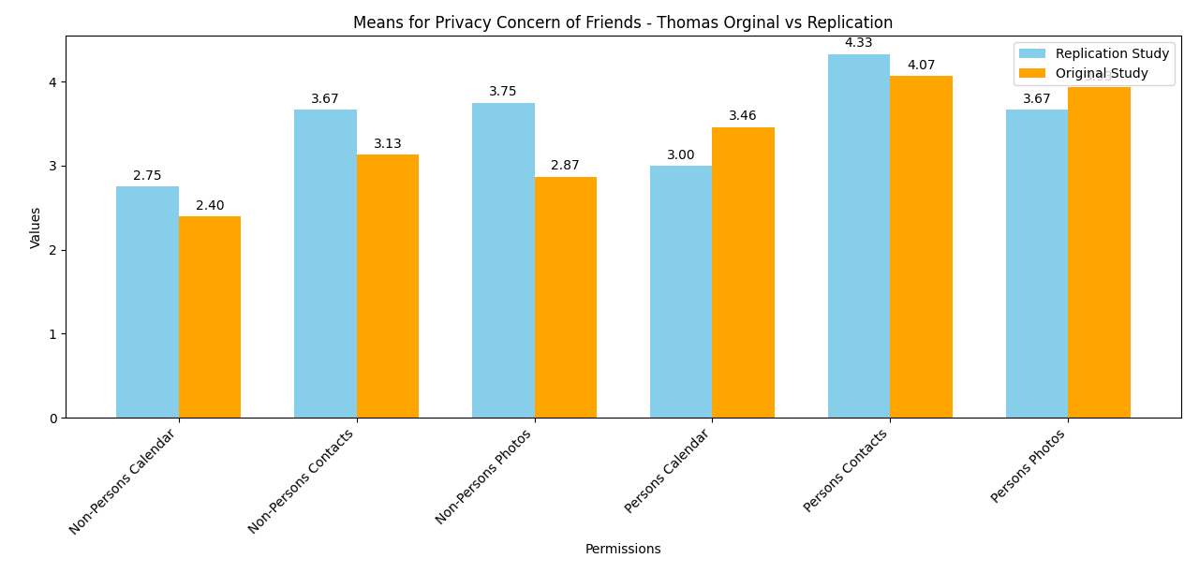
Means for Thomas’s friends Privacy Concern
Maximilian Marsch, Jens Grossklags, and Sameer Patil. 2021. Won't You Think of Others?: Interdependent Privacy in Smartphone App Permissions. Proc. ACM Hum.-Comput. Interact. 5, CSCW2, Article 437 (October 2021), 35 pages. https://doi.org/10.1145/3479581
*Higher is better

Slide 18
Means for Thomas’s friends Privacy Concern
Permission | Non-Persons | Persons | Difference
Calendar | 2.75 | 3 | 0.25
Contacts | 3.67 | 4.33 | 0.66
Photos | 3.75 | 3.67 | 0.08
File System | 3 | 3.8 | 0.8
Replication Study, n=32
Permission | Non-Persons | Persons | Difference
Calendar | 2.40 | 3.46 | 1.06
Contacts | 3.13 | 4.07 | 0.94
Photos | 2.87 | 3.93 | 1.06
Maximilian Marsch, Jens Grossklags, and Sameer Patil. 2021. Won't You Think of Others?: Interdependent Privacy in Smartphone App Permissions. Proc. ACM Hum.-Comput. Interact. 5, CSCW2, Article 437 (October 2021), 35 pages. https://doi.org/10.1145/3479581
Original Study, n=633
*Higher is better

Slide 19
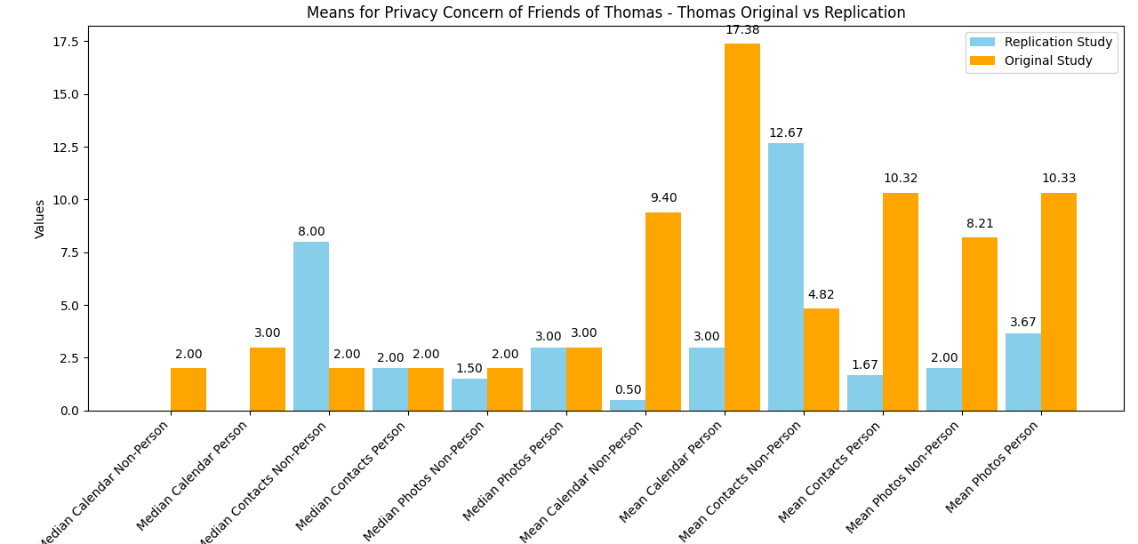
Mean, Median that participants were willing to pay to prevent data access
Maximilian Marsch, Jens Grossklags, and Sameer Patil. 2021. Won't You Think of Others?: Interdependent Privacy in Smartphone App Permissions. Proc. ACM Hum.-Comput. Interact. 5, CSCW2, Article 437 (October 2021), 35 pages. https://doi.org/10.1145/3479581
Original Study, n=633

Slide 20
Mean, Median that participants were willing to pay to prevent data access
Permission | Median Non-Person | Median Person | Mean Non-Person | Mean Person
Calendar | $0.00 | $0.00 | $0.50 | $3.00
Contacts | $8.00 | $2.00 | $12.67 | $1.67
Photos | $1.50 | $3.00 | $2.00 | $3.67
File System | $3.00 | $0.00 | $6.00 | $1.25
Replication Study, n=32
Permission | Median Non-Person | Median Person | Mean Non-Person | Mean Person
Calendar | $2.00 | $3.00 | $9.40 | $17.38
Contacts | $2.00 | $2.00 | $4.82 | $10.32
Photos | $2.00 | $3.00 | $8.21 | $10.33
Maximilian Marsch, Jens Grossklags, and Sameer Patil. 2021. Won't You Think of Others?: Interdependent Privacy in Smartphone App Permissions. Proc. ACM Hum.-Comput. Interact. 5, CSCW2, Article 437 (October 2021), 35 pages. https://doi.org/10.1145/3479581
Original Study, n=633

Slide 21
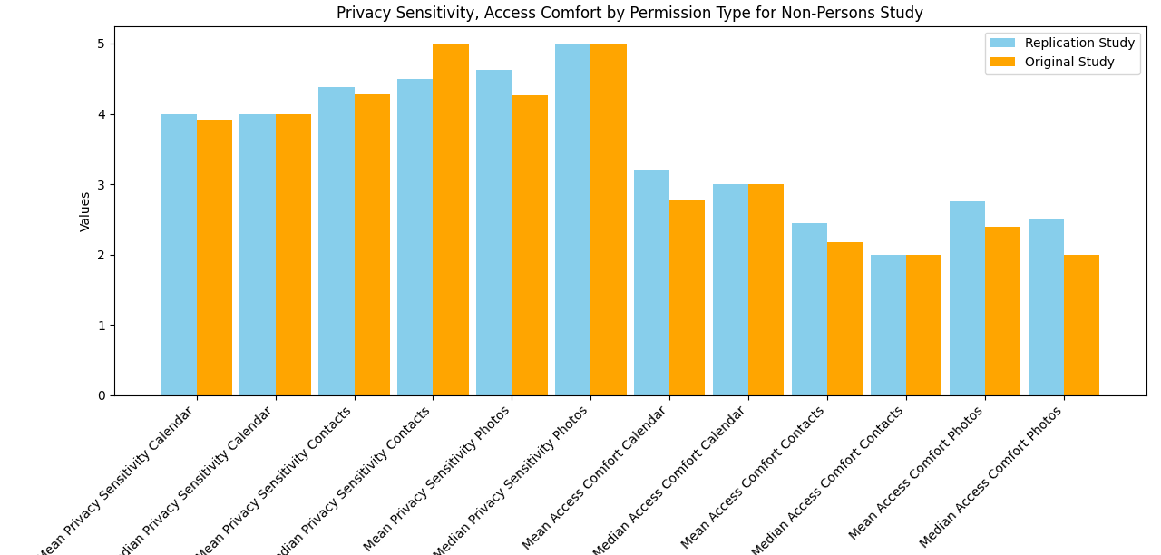
Privacy Sensitivity, Access Comfort by Permission Type for Non-Persons Study
Maximilian Marsch, Jens Grossklags, and Sameer Patil. 2021. Won't You Think of Others?: Interdependent Privacy in Smartphone App Permissions. Proc. ACM Hum.-Comput. Interact. 5, CSCW2, Article 437 (October 2021), 35 pages. https://doi.org/10.1145/3479581
*Lower is better

Slide 22
Privacy Sensitivity, Access Comfort by Permission Type for Non-Persons Study
Permission | Mean Privacy Sensitivity | Median Privacy Sensitivity | Mean Access Comfort | Median Access Comfort
Calendar | 4.00 | 4.00 | 3.19 | 3.00
Contacts | 4.38 | 4.50 | 2.44 | 2.00
Photos | 4.62 | 5.00 | 2.75 | 2.50
File System | 4.44 | 5.00 | 2.25 | 2.00
Replication Study, n=32
Permission | Mean Privacy Sensitivity | Median Privacy Sensitivity | Mean Access Comfort | Median Access Comfort
Calendar | 3.92 | 4.00 | 2.77 | 3.00
Contacts | 4.28 | 5.00 | 2.17 | 2.00
Photos | 4.26 | 5.00 | 2.39 | 2.00
Maximilian Marsch, Jens Grossklags, and Sameer Patil. 2021. Won't You Think of Others?: Interdependent Privacy in Smartphone App Permissions. Proc. ACM Hum.-Comput. Interact. 5, CSCW2, Article 437 (October 2021), 35 pages. https://doi.org/10.1145/3479581
Original Study, n=633
*Lower is better

Slide 23
RQ4: Willingness to Install Apps by Permission Type
Permission | Median Self-Willingness | Median Flip Self-Willingness | Mean Self-Willingness | Mean Flip Self-Willingness
Contacts | 1.00 | 1.00 | 1.33 | 1.00
Calendar | 2.00 | 2.00 | 1.80 | 2.00
Photos | 2.00 | 3.00 | 1.80 | 2.80
File System | 3.00 | 2.00 | 2.67 | 1.67
Persons Study
Permission | Median Self-Willingness | Median Flip Self-Willingness | Mean Self-Willingness | Mean Flip Self-Willingness
Contacts | 3.00 | 2.00 | 1.33 | 1.00
Calendar | 3.50 | 2.50 | 3.75 | 2.50
Photos | 3.00 | 2.00 | 2.80 | 2.20
File System | 1.00 | 1.50 | 1.25 | 1.50
Non-Persons Study
*Lower is better

Slide 24
Discussions
With n=32, any generalisability is not possible.
Even with less data, in support with original study, we found that the participants cared more for their own privacy than their friends.

Slide 25
Challenges and Future Work
Analysing less data was challenging.
Make changes to survey based on the feedback.
We aim to collect more data after IRB approval.

Slide 26
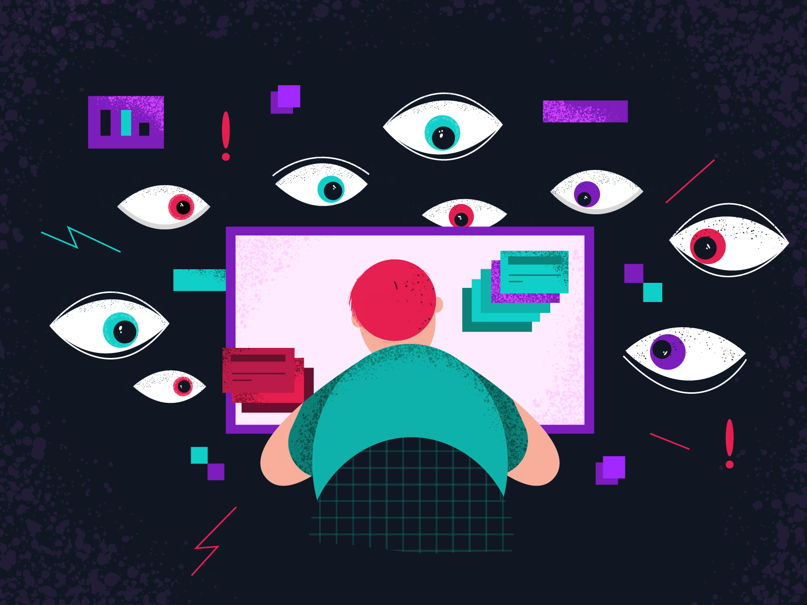
Questions?
Image from Dribbble

